Slide 1
Towards Controlled Generation of Text
Zhiting Hu Zichao Yang Xiaodan Lang Ruslan Salakhutdinov Eric P.Xing
Carnegie Mellon University
ICML 2017
Presenter: Anchit Bhattacharya
Arizona State University

Slide 2
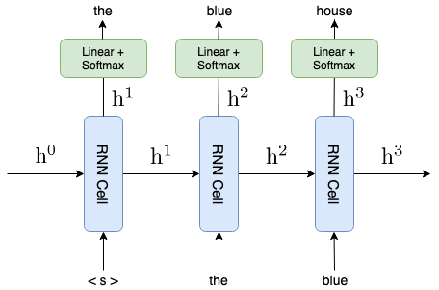
Text Generation Methods
RNN based text generation -
Train a RNN based language model and use it to generate the next token based on all previous tokens.
Can be character level or word level language model
Issues - Exposure Bias, Vanishing Gradient problem.

Slide 3
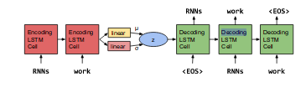
Text Generation Methods (Continued)
VAE based text generation -
Incorporates distributed latent representations of entire sentences.
Explicitly model holistic properties of sentences.

Slide 4
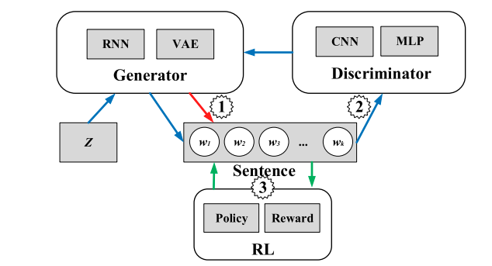
Text Generation Methods (Continued)
GAN based text generation -
Adversarial training to improve generated text.
Can be used as a training method on top of previous models.
Discriminator Network
Discriminator Network

Slide 5
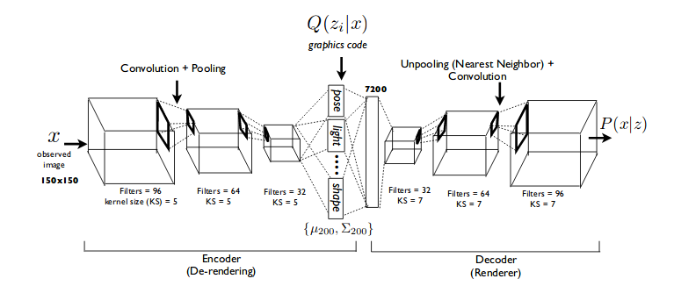
Disentangled Representations
Neurons in the neural network are somehow learning complete concepts alone.
We want the latent representation of the texts to be disentangled, so that we can control the generation effectively.

Slide 6
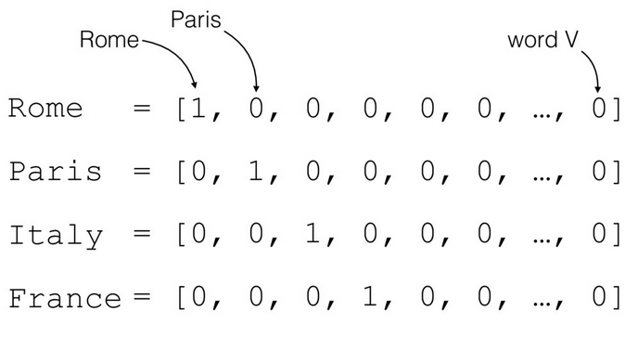
Challenges for Controllable Text Generation
1> Discrete Nature of Text Samples - Difficult to do backpropagation and train the generator in adversarial based methods.
2> Learning Disentangled representations - Lacks explicit enforcement of independence property on full latent representation.
3> Controlled Generation of Text - Control the generation of text based on some properties generically. Byproduct of point 2.

Slide 7
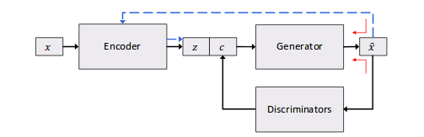
Model
Discrete Nature(Solution)
Continuous Approximation based on softmax with a decreasing temperature(T).
x = softmax(o | T)
Low variance and fast convergence as opposed to Policy Gradient based method.

Slide 8
Model
Controlled Generation Solution
Add a structured code to the latent representation for every attribute that needs to be controlled.
z - Gaussian prior
c - Continous/Discrete
Different discriminator for each attribute

Slide 9
Model
Generator Training(Part1)
Train parameters of Encoder(Theta_{e}) and Generator(Theta_{g}) based on the reconstruction Error of real sentences.
Also, train the encoder so that the latent representation is close to a Gaussian prior.
Mathematically:-
L_{VAE}(θ_{G},θ_{E};x) = KL(q_{E}(z|x)‖p(z)) − E_{qE(z|x)qD(c|x)}[logp_{G}(x|z,c)],
Forcing latent code towards Gaussian prior
Loss function

Slide 10
Model
Generator Training(Part 2)
Discriminator produces extra learning signals enforcing the generator to produce text with certain attributes conditioned on code.
It is still possible that other attributes not explicitly modelled may also entangle with the code.
Mathematically:-
L_{Attr,c}(θ_{G}) = −E_{p(z)p(c)}[ log_{qD}(c| Gτ(z,c))]
Loss function
Train the generator based on discriminator O/P of generated text

Slide 11
Model
Generator Training(Part 3)
We reuse the Encoder as a discriminator, and match it with the unstructured code(z)
Unstructured code
Structured code
O/P is z instead of c
Mathematically:-
L_{Attr,z}(θ_{G}) = −E_{p(z)p(c)}[ log_{qE}(z| Gτ(z,c))]
Loss function
Train the generator based on discriminator O/P of generated text

Slide 12
Model
Generator Training(Overall Loss)
Overall Loss is the sum of all the losses.
λ_{c} and λ_{z} are balancing parameters for the loss
Unstructured code
Structured code
Overall Loss function:-
min_{θG}L_{G}= L_{VAE}+ λ_{c}L_{Attr,c}+ λ_{z}L_{Attr,z},
Loss function

Slide 13
Model
Discriminator Training
Can be formulated as a sentence classifier for categorical code, or a probabilistic regressor for continuous code.
Use labelled examples to train the discriminator, to embed the text characteristics into the code.
Unstructured code
Structured code
Mathematically:-
Ls( θD ) = − EXL [ log _{qD}(c_{L}|x_{L}) ]
Training on labelled data

Slide 14
Model
Discriminator Training
Use samples generated from generator as a augmented data for training the discriminator
Use labelled examples to train the discriminator, to embed the text characteristics into the code.
Unstructured code
Structured code
Mathematically:-
Lu(θD) = − E_{pG(ˆx|z,c)p(z)p(c)} [ logqD(c|x) + β H( qD( c′|ˆx ) ) ],
Training discriminator on generator data
Shannon entropy on generated data to compensate for noisy data from generator

Slide 15
Model
Discriminator Training(Overall Loss)
Use samples generated from generator as a augmented data for training the discriminator
Use labelled examples to train the discriminator, to embed the text characteristics into the code.
Unstructured code
Structured code
Overall loss function :-
min_{θD}LD = Ls + λu Lu

Slide 16
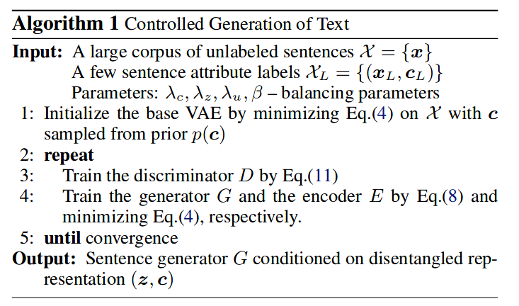
Training

Slide 17
Experiments
Generate short sentences(length <= 15)
Sentence corpus - IMDB text corpus(1.4m)
Sentiment -
SST dataset - 6920/872/1821
IMDB review datasets - 5K/1K/10K
SST small - 250 labelled samples
Lexicon - word level sentiment labels
Tense -
Dataset of labelled words
5250 words and phrases labeled with one of {“past”, “present”, “future”}

Slide 18
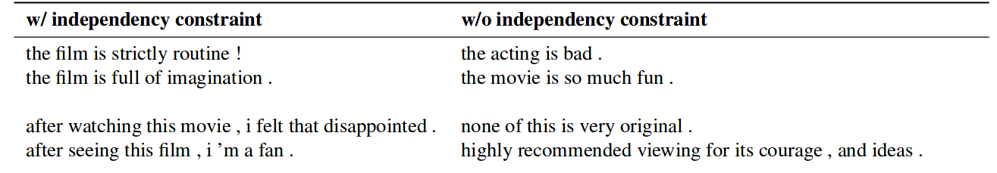
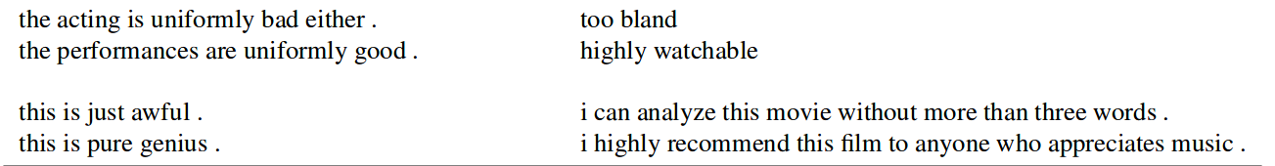
Results (Disentangled Representation)

Slide 19
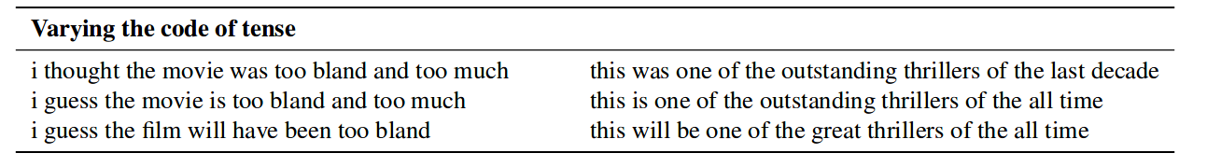
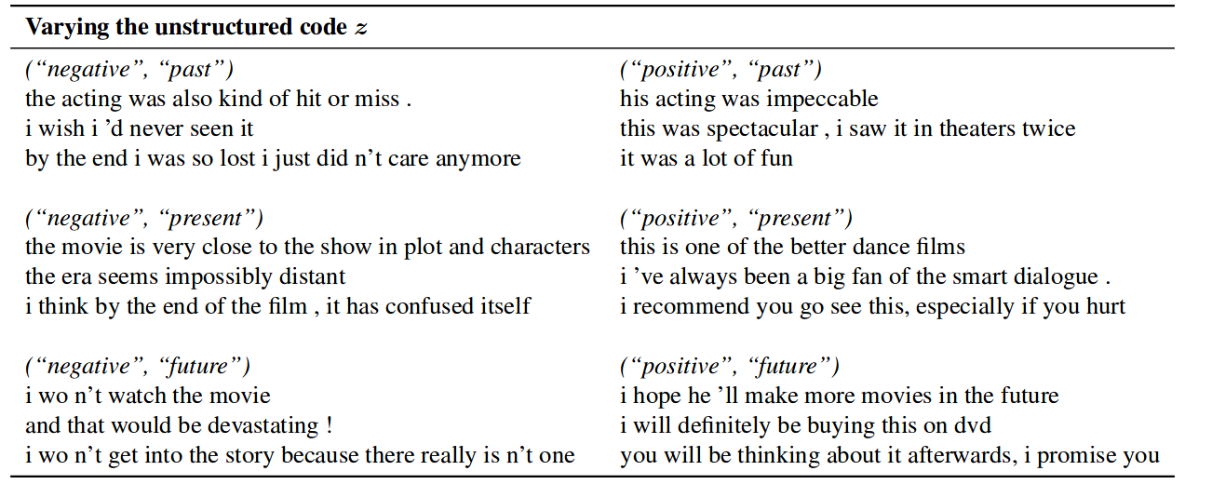
Results (contd..)

Slide 20
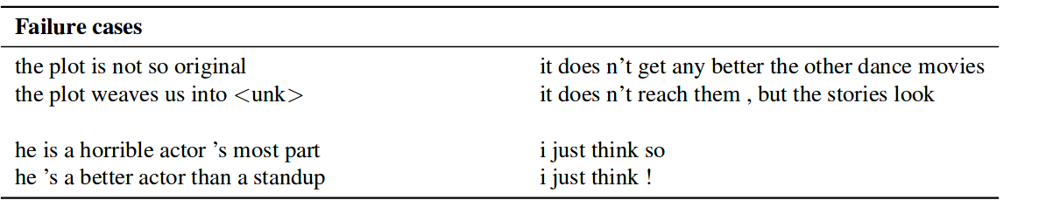
Results (contd...)

Slide 21
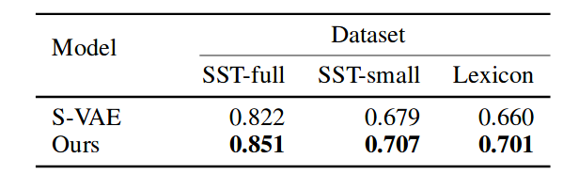
Results(Sentiment Accuracy)

Slide 22
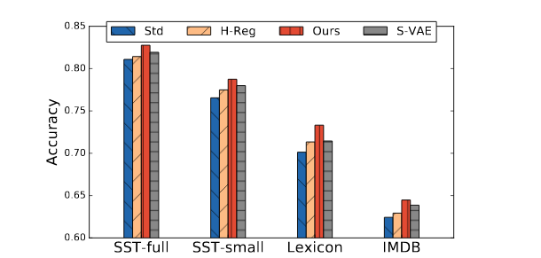
Results(Data Augmentation)

Slide 23
Questions

